Slide 1

A Presentation On Visual Representation of Data Structures Course Title: Application Development Sessional
Course Code: CSE 252 Presented By Md. Mostafijur Rahman (1902073)
Hajee Mohammad Danesh Science and Technology University,
Dinajpur-5200

Slide 2

Outline
Introduction
Main Objectives
Tools and Technology
Modules
Output
Conclusion
Limitation
Future work

Slide 3

Introduction
Project name: Visual Representation of Data Structures
Key Features of this project:
Visualization of different data structures
Insertion, deletion and searching any data from an array
Randomly generation of data for completing sorting operations
Visualization the way by which any one can get idea about the data structure
Attached several mechanisms of any algorithms shown by using interactive buttons
Some animations are applied for effectiveness of algorithms
Overall mechanisms are shown in different frame with different popup view

Slide 4

Objectives
To assist computer science educators how to learn data structures and algorithms easily.
To make more understandable and effective use of algorithms.
To provide the knowledge of basic data structures and their implementations.
To understand importance of data structures in visual context of writing efficient programs.
To build large application in future using such graphical user interface .
To develop skills to apply appropriate data structures in problem solving.

Slide 5



Tools and Technology
Language: Java
For GUI: Java Toolkit- Java Swing
Integrated Development Environment: NetBeans
Operating System : Windows 10
RAM: 4.00 GB

Slide 6

Modules
Home Page
Adding and Searching Representation
Linked List Representation
Stack Representation
Queue Representation
Sorting Representation
Bubble sort
Radix sort
Insertion sort
Selection sort
Tower of Hanoi Representation

Slide 7

Output
The outputs of different modules of our application are shown by the screenshots and also showing the explanation

Slide 8
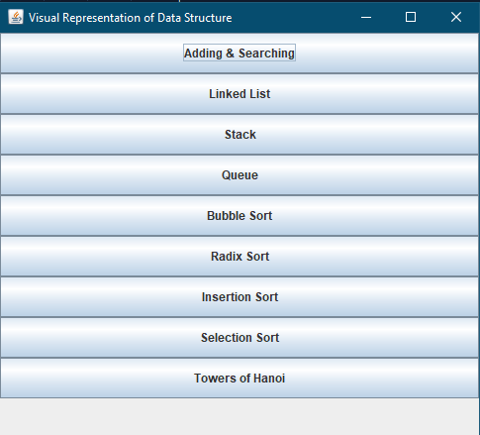
Home Page
Figure-1: Home page
8

Slide 9
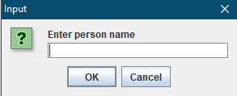
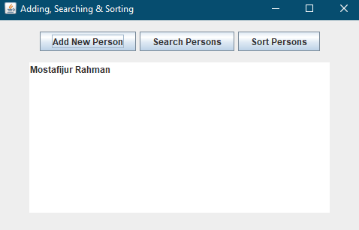
Adding and Searching
ShowInputDialogue Popup
Searching elements where their position matches
Sorting elements in alphabetical order
Figure-2: Adding and Searching
9

Slide 10
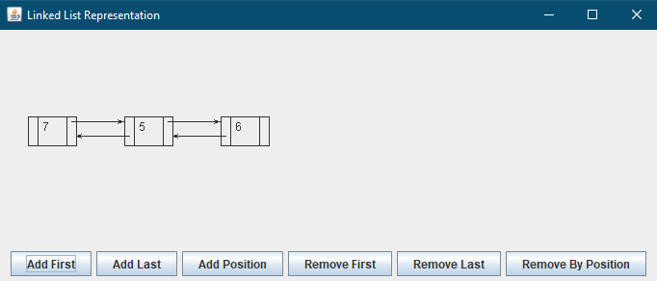
Linked List Representation
Linked List area-
Where elements to be inserted and linked next node to the previous node
Addition and Deletion any elements from first, last or any desired location
Figure-3: Linked List Representation

Slide 11
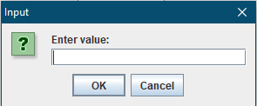
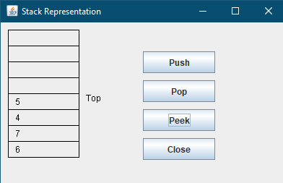
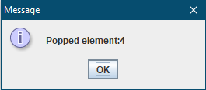
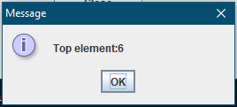
Stack Representation
Input dialogue Popup
Stack area where elements to be inserted
Top Element Deletion
Showed Top element
Figure-4: Stack Representation

Slide 12
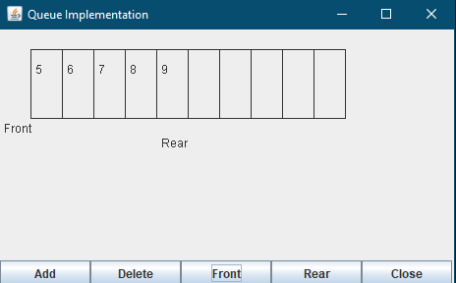
Queue Representation
Element added as rear
Peeked Front and Rear Element
Front element deleted
Figure-5: Queue Representation
12

Slide 13
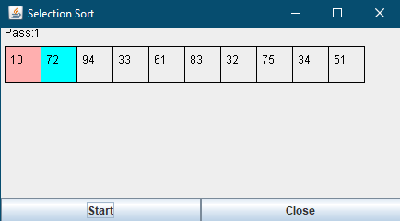
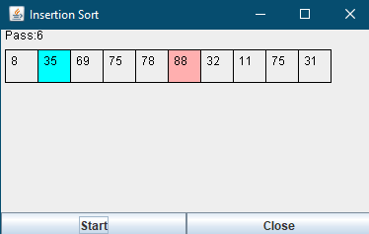
Sorting Representation
Selection Sort
Insertion Sort
These colors compare elements and showing pass number
Randomly generated array elements and sorting started
Figure-6 : Selection Sort
Figure-7: Insertion Sort
Notes:
Randomly generates elements of the array and sorting them by using the proper data structures and algorithms and also showing their passes.

Slide 14
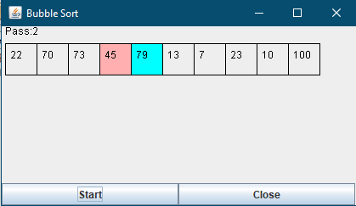
Sorting Representation
Bubble Sort
These colors compare elements and showing pass number
Randomly generated array elements and sorting started
Figure- 8: Bubble Sort
Notes:
Randomly generates elements of the array and sorting them by using the proper data structures and algorithms and also showing their passes.

Slide 15
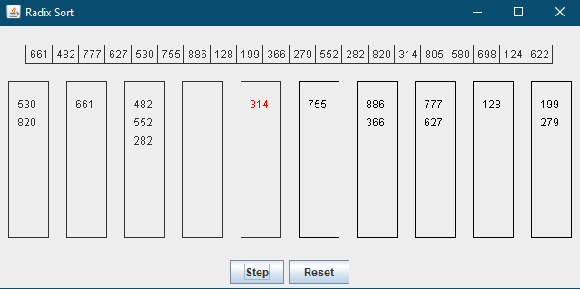
Sorting Representation
Radix Sort
Frequently clicking this button to do all steps
Randomly generated array elements
Figure-9 : Radix sort

Slide 16
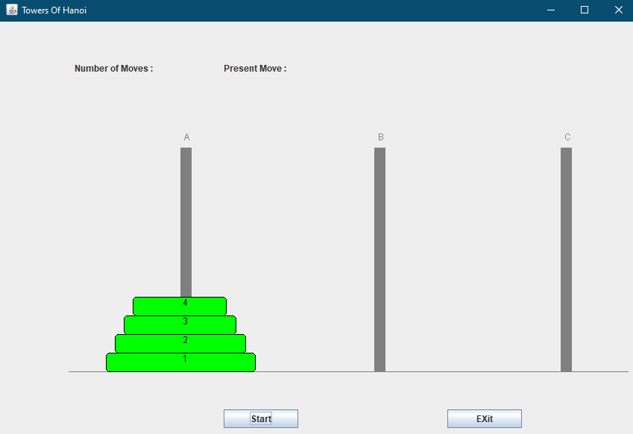
Tower of Hanoi Representation
Showing
Minimum number of moves and present move
Destination tower
Source tower
Different Disks
Figure-10 : Tower of Hanoi

Slide 17

Conclusion
Main goal of this project is to help computer science educators to understand algorithms easily
Visualized algorithms graphically in every section
Using some methods attractive look and feel features are added
Some animations are added to make GUI integrative
Help the programmers to build large application using this kind of application

Slide 18

Limitation
Few data structures are used
Can’t not provide huge data set
Simply user interface
Less functions are used
Sorting algorithms are time consuming.
Run on only desktop or laptop

Slide 19
Future work
Work on more data structures
Try to use more data sets
Make the user interface more interactive and efficient
More functions will be used to make algorithms more understandable
Make the application compatible for any environment

Slide 20
THANK You!

